Slide 1


Santosh Kumar Kar,
skkar.2k2@gmail.com

Slide 2
CHAPTER – 9
Spring Boot – Exception Handling

Slide 3
Exception Handling
@ResponseStatus(HttpStatus.NOT_FOUND)
public class EmployeeNotFoundException extends Exception {
private static final long serialVersionUID = -6794664688183647302L;
public EmployeeNotFoundException() {
super();
}
public EmployeeNotFoundException(String message) {
super(message);
}
public EmployeeNotFoundException(String message, Throwable cause) {
super(message, cause);
}
public EmployeeNotFoundException(Throwable cause) {
super(cause);
}
}

Slide 4
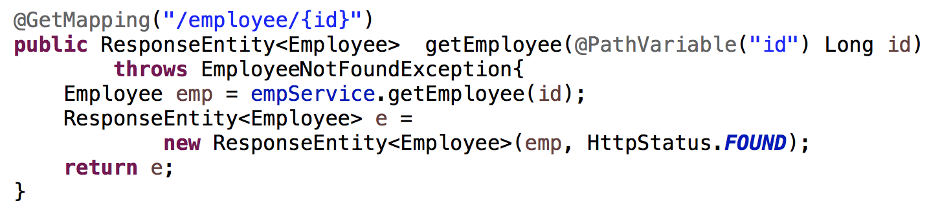
Exception Handling

Slide 5
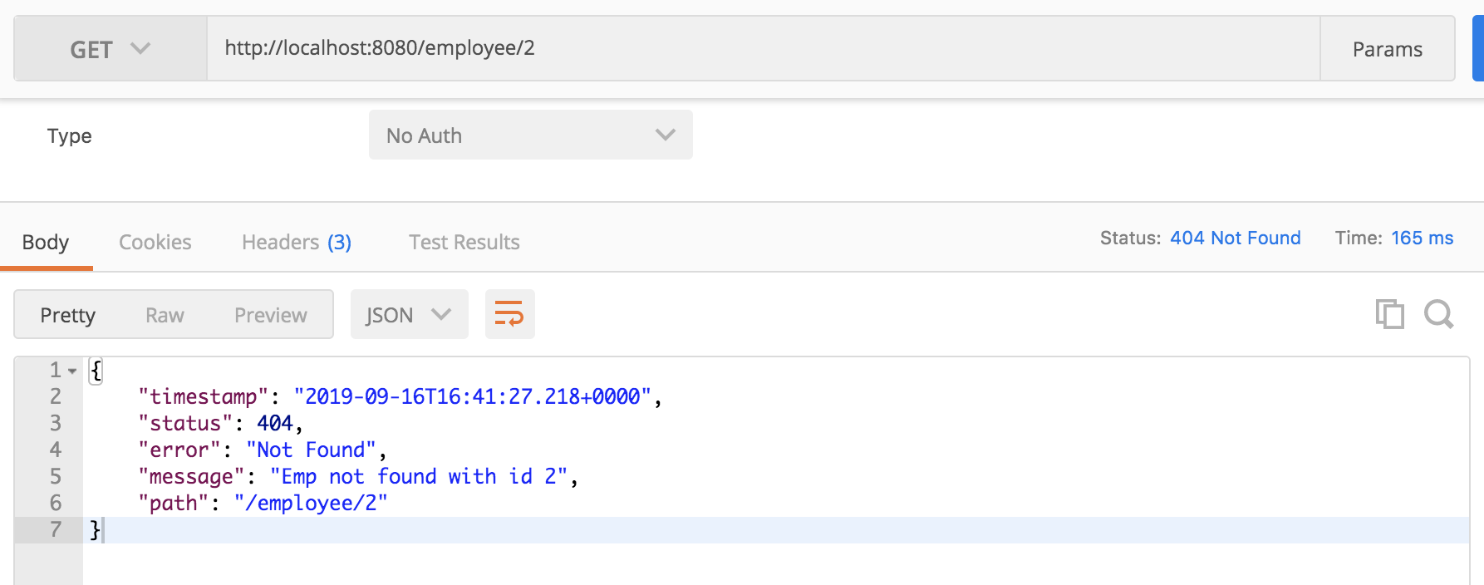
Exception Handling

Slide 6
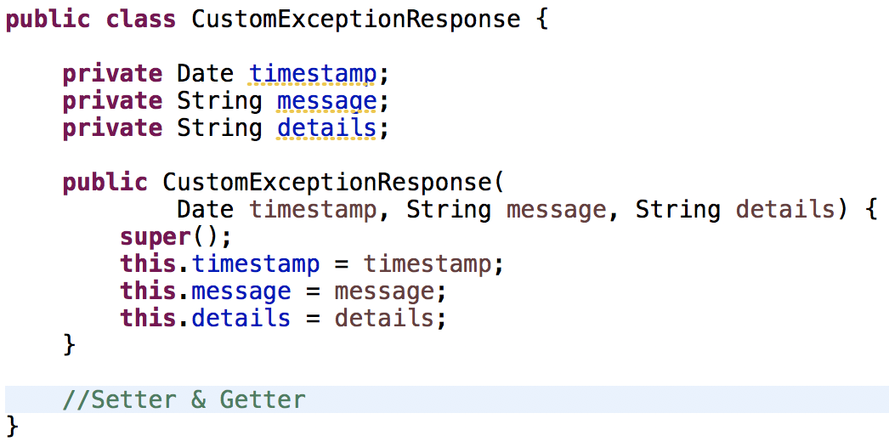
Customizing Exception Response
1. Customize the Response

Slide 7
Customizing Exception Response
2. Write Custom Exception Handler
@ControllerAdvice
@RestController
public class CustomExceptionHandler
extends ResponseEntityExceptionHandler{
// Implement Custom Exception Handlers here
}

Slide 8
Customizing Exception Response
Write Custom Exception Handler
For any specific Exception
/*
EmployeeNotFoundException
*/
@ExceptionHandler(EmployeeNotFoundException.class)
public final ResponseEntity<CustomExceptionResponse> handleUserNotFoundException(Exception ex, WebRequest request) {
CustomExceptionResponse response =
new CustomExceptionResponse(
new Date(), ex.getMessage(), request.getDescription(false));
return new ResponseEntity<CustomExceptionResponse>(
response, HttpStatus.NOT_FOUND);
}

Slide 9
Customizing Exception Response
Write Custom Exception Handler
For any specific Exception
/*
Generic Exception
*/
@ExceptionHandler(Exception.class)
public final ResponseEntity<CustomExceptionResponse> handleAnyException(Exception ex, WebRequest request) {
CustomExceptionResponse response =
new CustomExceptionResponse(
new Date(), ex.getMessage(), request.getDescription(false));
return new ResponseEntity<CustomExceptionResponse>(
response, HttpStatus.INTERNAL_SERVER_ERROR);
}

Slide 10

Questions
Send to skkar.2k2@gmail.com

